Slide 1
Jermyn Borough Council Meeting
12/15/22

Slide 2
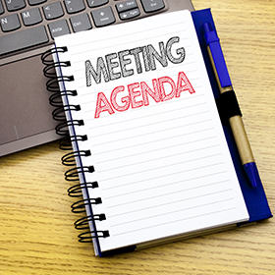
Meeting Agenda
December 15, 2022
CALL TO ORDER
PLEDGE OF ALLEGIANCE
ROLL CALL
PREVIOUS MEETING MINUTES
TREASURER REPORT/BILLS PAYABLE
PRESENTATION LAKELAND GIRLS CROSS COUNTRY TEAM
CORRESPONDENCE
PUBLIC COMMENT
ADOPTION OF 2023 BUDGET AND TAX/GARBAGE FEE RESOLUTION
NOR LACK
TRASH PICK UP TRANSITION
PROFESSIONAL REPORTS
POLICE
FIRE
SOLICITOR- (EASEMENT PROGRESS UPDATE)
CODE ENFORCEMENT
ZONING
ENGINEER
TAX COLLECTOR
MAYOR
COMMITTEE REPORTS
NEW BUSINESS

Slide 3
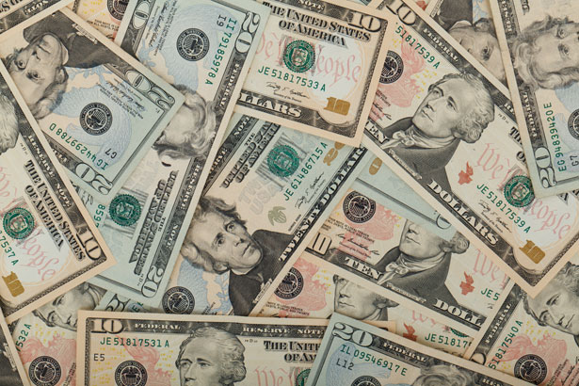
Treasurer’s report
12/15/22
ASSETS
Checking/Savings
Capital Reserve - DPW 10,727.54
Capital Reserve - Police 4,871.82
Crime Watch Fund 222.69
General Fund - Community 104,083.36
General Fund - FNB 5,972.92
Holiday Lights Fund 1,424.09

Slide 4
Treasurer’s report
Investment - General Fund 1,010.83
Investment - Liquid Fuels 34,128.28
Investment - Paving Fund 1,021.33
Investment - Recycling 5,049.91
Investment - Refuse 2,624.39
Liquid Fuels - FNB 5,610.32
Petty Cash 231.00
Recreations Fund 23,877.34
Recycling - Community 11,693.84
Refuse Checking - FNB 58,885.65
Total Checking/Savings 271,435.31

Slide 5
Treasurer’s report
200000 · Accounts Payable 52,043.84
Long Term Debt 241,301.41

